Slide 1

OUTPUT DEVICE

Slide 2





OUTPUT DEVICE
Convert (digital) computer data into something useful for humans in external world:
Images
Music
Movies
Documents
Many different types
A few general purpose
Mostly specialised

Slide 3
COMMONLY USED OUTPUT DEVICES
Monitors
Printers
Plotters
Screen image projector
Voice response systems

Slide 4
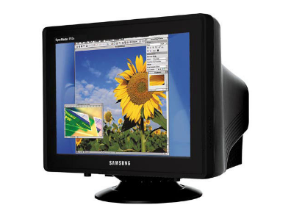
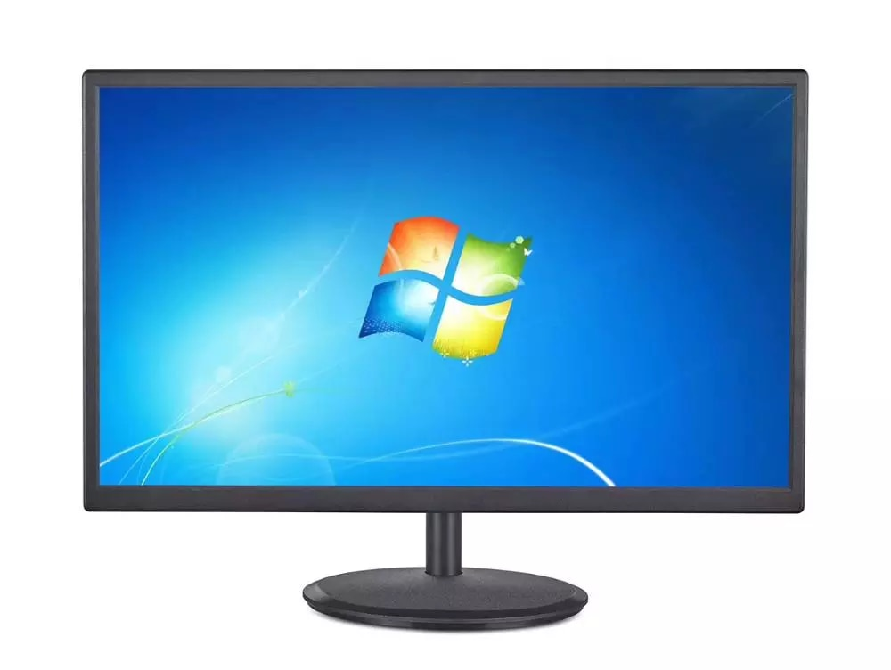
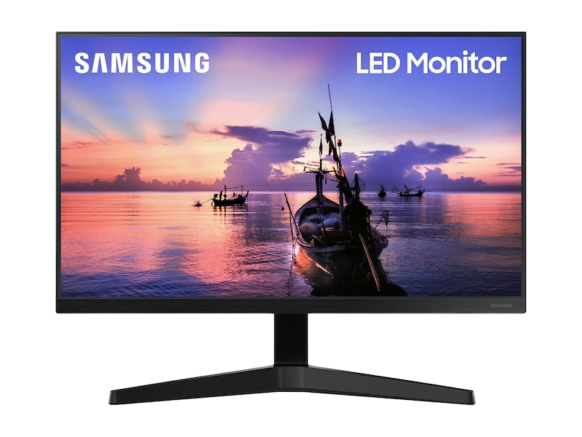
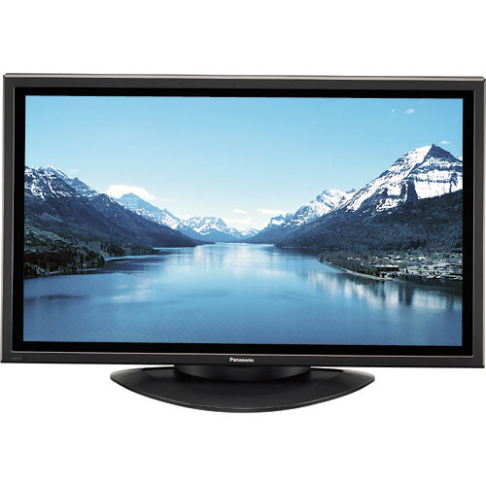
MONITOR
Used to be called a Visual Display Unit (VDU)
Used to use Cathode Ray Tube (CRT) like old TVs
Now flat screen like modern TVs
Liquid Crystal Display (LCD)
Plasma
Lower weight and size
Use less power
Do not flicker (good ergonomic feature)
CRT
LCD
LED
Plasma

Slide 5
MONITOR
Screen sizes vary enormously:
Smartphone
Tablet
Netbook
Laptop
Desktop
Home TV for PC

Slide 6
PRINTER
Device for getting computer-based (digital) information onto paper
‘Soft-copy’ to ‘hard-copy’
Various technology evolutions:
Dot matrix: An ‘impact’ printer, hitting an inked ribbon on to the paper. Obsolete now.
Inkjet: Squirts jets of ink onto paper - very fine control available. Multiple ink colours available and cheap to buy. Can be expensive to run (ink cartridges) but good for home use (photo printers) & small offices.
Different types of printer & working procedure
https://www.youtube.com/watch?v=JEVurb1uVFA

Slide 7
DOT MATRIX PRINTER
Character printers that form characters and all kinds of images as a pattern of dots
Print many special characters, different sizes of print and graphics such as charts and graphs
Impact printers can be used for generating multiple copies by using carbon paper or its equivalent
Slow, with speeds usually ranging between 30 to 600 characters per second
Cheap in both initial cost and cost of operation

Slide 8
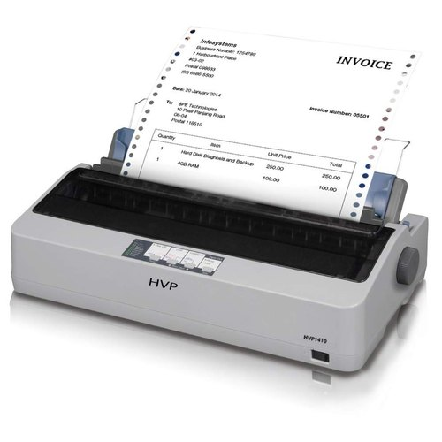
DOT MATRIX PRINTER
Formation of Characters as a pattern of dots
ABCDEFGHIJKLMNOPQRSTUVWXYZ
0123456789-.,
&/$*#%@=(+)
https://www.youtube.com/watch?v=I_VBe3OO9dI

Slide 9
INK JET PRINTER
Character printers that form characters and all kinds of images by spraying small drops of ink on to the paper
Print head contains up to 64 tiny nozzles that can be selectively heated up in a few micro seconds by an integrated circuit register
To print a character, the printer selectively heats the appropriate set of nozzles as the print head moves horizontally
Can print many special characters, different sizes of print, and graphics such as charts and graphs

Slide 10
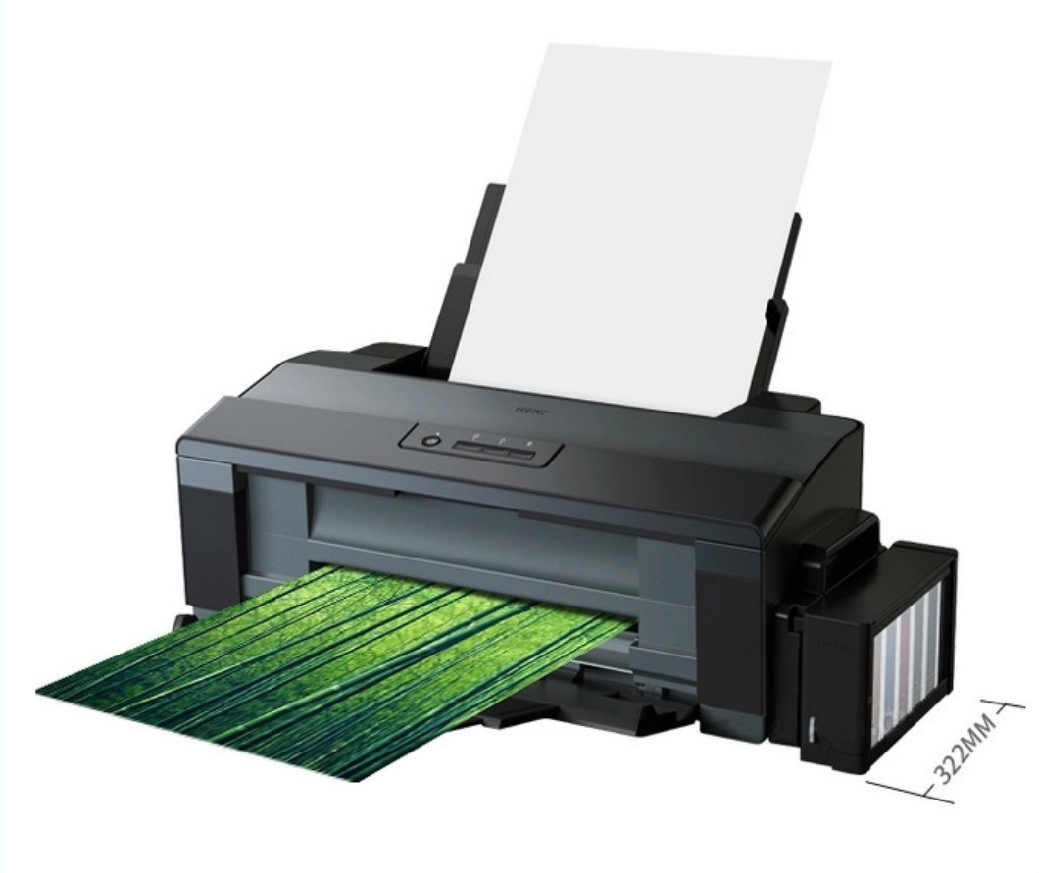
INK JET PRINTER
Non-impact printers. Hence, they cannot produce multiple copies of a document in a single printing
Can be both monochrome and color
Slower than dot-matrix printers with speeds usually ranging between 40 to 300 characters per second
More expensive than a dot-matrix printer
How ink jet printer works
https://www.youtube.com/watch?v=9yeZSaigBj4

Slide 11
DRUM PRINTER
Line printers that print one line at a time
Have a solid cylindrical drum with characters embossed on its surface in the form of circular bands
Set of hammers mounted in front of the drum in such a manner that an inked ribbon and paper can be placed between the hammers and the drum
Can only print a pre-defined set of characters in a pre- defined style that is embossed on the drum
Impact printers and usually monochrome
Typical speeds are in the range of 300 to 2000 lines per minute
https://www.youtube.com/watch?v=wlL8zMhxyes

Slide 12







PRINTING MECHANISAM OF DRUM PRINTER
Hammers (one for each band)
Paper
Ribbon
W W W W W W W W W W W W W W V V V V V V V V V V V V V V
U U U U U U U U U U U U U U
Solid cylindrical drum with embossed characters
T T T T T T S S S S S S R R R R R R
T T T T T T T T S S S S S S S S R R R R R R R R
Q Q Q Q Q Q Q Q Q Q Q Q Q Q
P P P P P P P P P P P P P P O O O O O O O O O O O O O O
N N N N N N N N N N N N N N
Total number of bands is equal to the maximum number of characters (print positions) on a line

Slide 13
LASER PRINTER
Page printers that print one page at a time
Consist of a laser beam source, a multi-sided mirror, a photoconductive drum and toner (tiny particles of oppositely charged ink)
To print a page, the laser beam is focused on the electro statically charged drum by the spinning multi-sided mirror
Toner sticks to the drum in the places the laser beam has charged the drum’s surface.
Toner is then permanently fused on the paper with heat and pressure to generate the printer output
Laser printers produce very high quality output having resolutions in the range of 600 to 1200 dpi
How it works - https://www.youtube.com/watch?v=WB0HnXcW8qQ

Slide 14
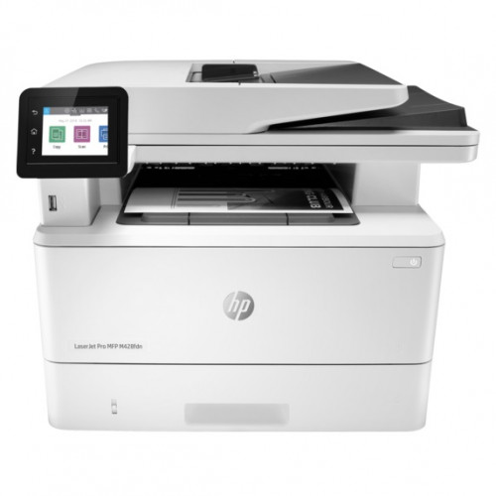
LASER PRINTER

Slide 15
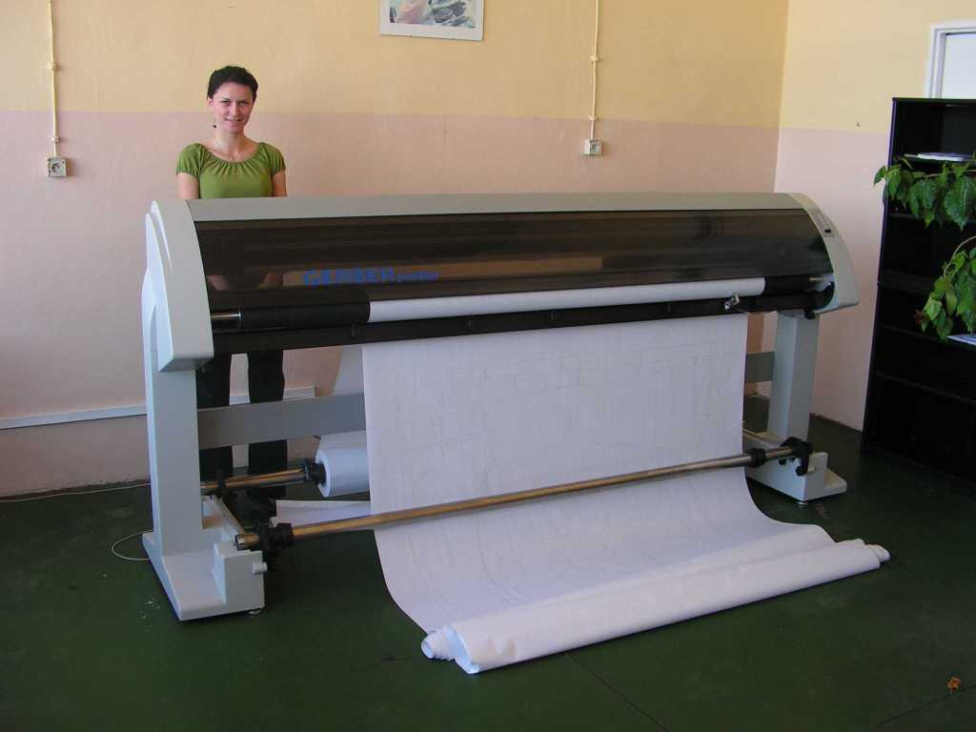
PLOTTER
Uses vector or co-ordinate (x-y) graphics to drive pens over paper or uses inkjet technology over much larger than standard paper
Excellent for detailed drawings and plans
Good for very large sheets
Specialist applications like:
Architectural drawings
Digital mapping
Engineering drawings

Slide 16
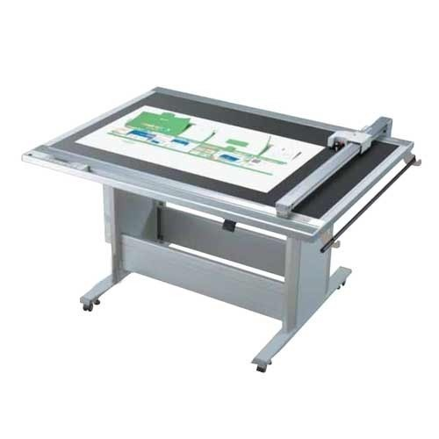
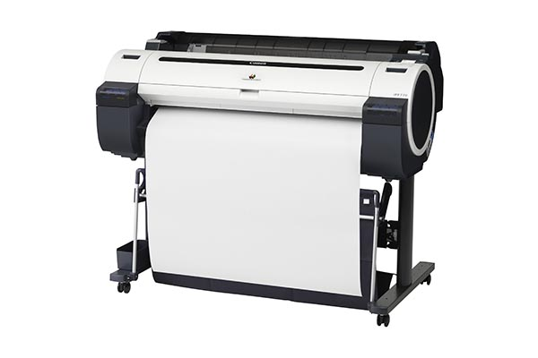
PLOTTER
Two commonly used types of plotters are:
Drum plotter, in which the paper on which the design has to be made is placed over a drum that can rotate in both clockwise and anti-clockwise directions
Flatbed plotter, in which the paper on which the design has to be made is spread and fixed over a rectangular flatbed table
Drum Plotter
Flatbed Plotter

Slide 17
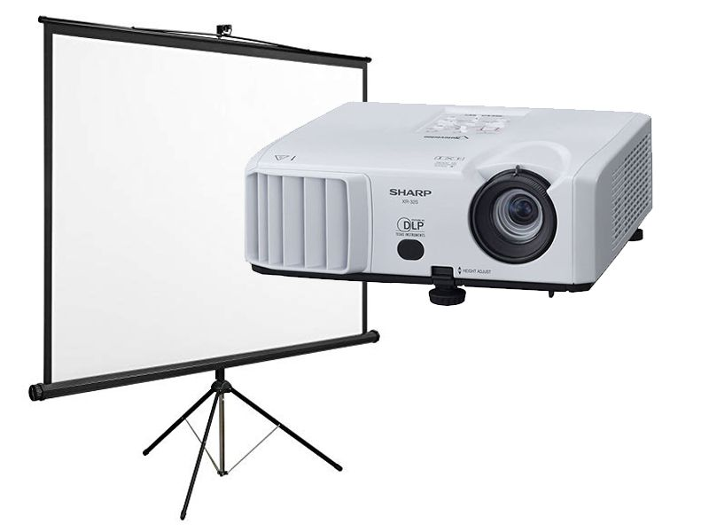
SCREEN IMAGE PROTECTOR
An output device that can be directly plugged to a computer system for projecting information from a computer on to a large screen
Useful for making presentations to a group of people with direct use of a computer
Full-fledged multimedia presentation with audio, video, image, and animation can be prepared and made using this facility

Slide 18
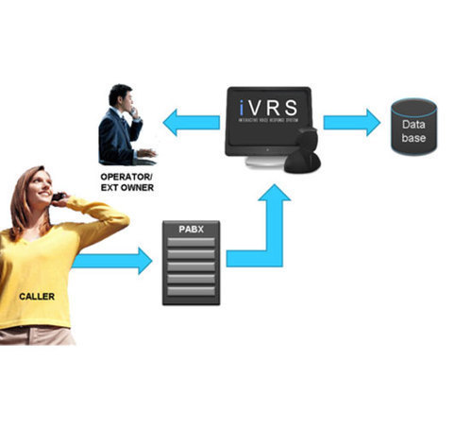
VOICE RESPONSE SYSTEM
Voice response system enables a computer to talk to a user
Has an audio-response device that produces audio output
Such systems are of two types:
Voice reproduction systems
Speech synthesizers

Slide 19
QUICK BRAIN – Sample Question 1
What is Output device?
Which device can perform both input & output operations in a computer system? Briefly explain

